Slide 1

Team Name : DevMistri
Team Leader Name : Nikhil Sharma and Puja Chattopadhyay
Problem Statement : Empowering Small-Scale Farmers with Digital Tools for Better Decision-Making

Slide 2

Brief about the Idea
KrishiSahayak is a comprehensive, multilingual, AI-powered mobile platform designed to empower over 160 million Indian farmers with real-time agricultural intelligence. The platform integrates with Government of India’s Digital Public Infrastructure (DPI) including IMD weather services, AGMARKNET market prices, AgriStack farmer registry, and Bhashini for 22+ Indian languages.
The solution provides farmers with 7-day weather forecasts, location-based crop recommendations using GAEZ v4 framework, crop rotation planning, government scheme discovery, real-time mandi prices, disease detection via AI vision models, IoT device integration, and a voice-powered AI agent for natural language queries in their native language.

Slide 3
What Makes KrishiSahayak Different
Deep DPI Integration: First platform to integrate all major Government DPIs – IMD, AGMARKNET, AgriStack UFSI, and Bhashini – creating a unified farmer experience
Voice-First AI for Low Literacy: Bhashini-powered voice agent in 22+ languages enables farmers with limited digital literacy to access critical information through natural conversation
Offline-First Architecture: Critical features work without internet connectivity, addressing India’s rural connectivity challenges with cached weather, schemes, and crop data

Slide 4
Core Features
Weather Intelligence
7-day IMD forecasts, nowcast alerts, agromet advisories
Crop Recommendations
GAEZ-based suitability, rotation planning, yield prediction
Government Schemes
Central and state scheme discovery, eligibility checking
Market Intelligence
Real-time AGMARKNET mandi prices, trend analysis, alerts
AI-Powered Tools
Disease detection, voice agent (22+ languages), IoT integration

Slide 5
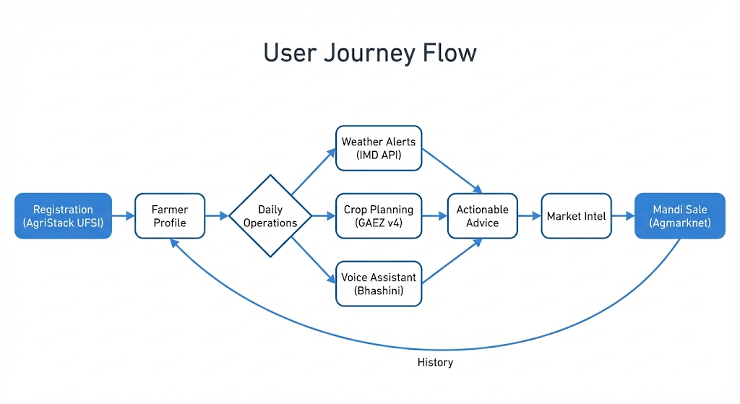
User Journey Flow
1. Registration & Onboarding
Farmer signs up via AgriStack UFSI → Profile creation with farm details
2. Daily Weather Check
View 7-day forecast → Receive alerts → Plan activities (sowing, irrigation)
3. Crop Planning
Get recommendations → Plan rotation → Estimate yields → Track inputs
4. Voice Assistance
Ask questions in native language → Get instant answers via voice/text
5. Market Intelligence
Check mandi prices → Find nearest mandi → Decide harvest timing

Slide 6
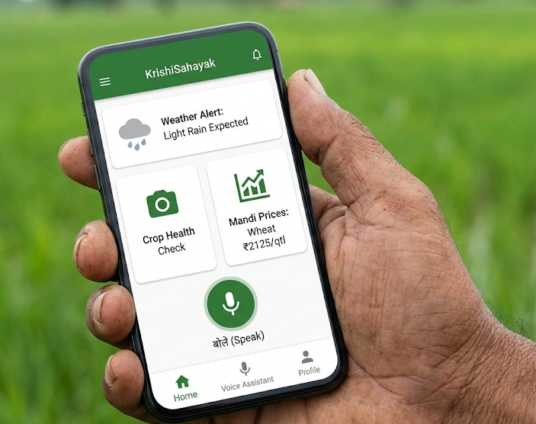
Key Features Dashboard
Farmer Dashboard
Unified view of farm status, weather alerts, upcoming activities, yield predictions
Voice Interface
Push-to-talk interface with conversation history, language selector, text fallback
Disease Detection
Camera-based capture, AI analysis, treatment recommendations, expert referrals
Admin Portal
Document upload, scheme management, vector search, user analytics, audit logs

Slide 7
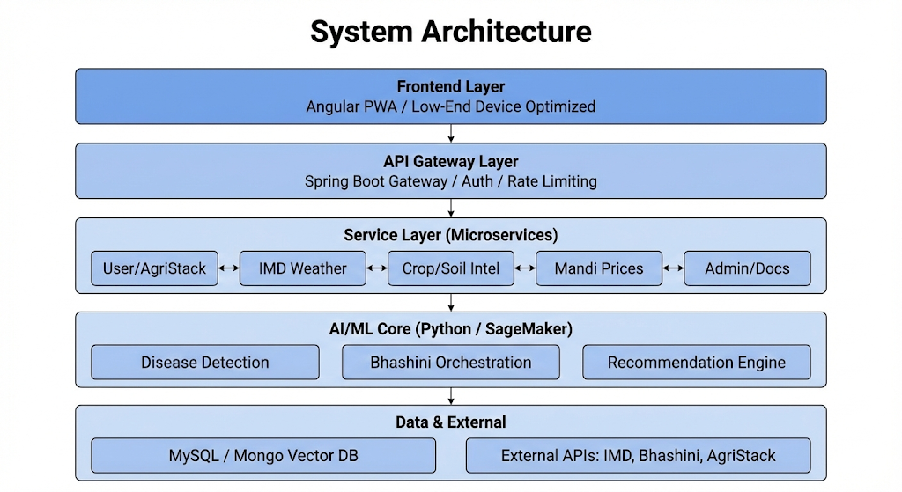
System Architecture
Frontend Layer
Angular Progressive Web App, optimized for low-end devices
Backend Services
Spring Boot microservices (User, Weather, Crop, Scheme, Mandi, IoT, Admin)
AI/ML Services
Python (disease detection, yield prediction, recommendations, voice orchestration)
Data Layer
MySQL (transactional), MongoDB (vector search), Redis (caching)
External Integrations
IMD Weather, AGMARKNET, AgriStack UFSI, Bhashini APIs

Slide 8
Technology Stack
Frontend
Angular 18, TypeScript, Progressive Web App, Service Workers
Backend
Spring Boot 3.x (Java 17), Spring Cloud, Spring Security, REST APIs
AI/ML
Python 3.11, TensorFlow/PyTorch, FastAPI, scikit-learn, pandas
Databases
MySQL 8.0, MongoDB 7.0 (vector search), Redis 7.0
DevOps & Cloud
AWS (EC2, RDS, S3, Lambda), Docker, Kubernetes, CI/CD pipelines

Slide 9
Implementation & Expected Impact
Deployment Strategy
AWS Infrastructure (EC2, RDS, S3), Kubernetes orchestration, CI/CD pipelines
Scalability
Designed for 1M+ concurrent users with horizontal scaling and 99.5% uptime SLA
Expected Impact
15-20% increase in crop yields through optimized planning and timely interventions
Financial Benefits
Better market prices via timing optimization, reduced input costs through precision farming

Slide 10
AWS AI Services Integration
Amazon SageMaker
Training and deploying ML models for disease detection and yield prediction
Amazon Bedrock
Powering voice agent with foundation models for intelligent conversations
Amazon Rekognition
Image analysis for crop disease detection and pest identification
AWS Lambda
Serverless functions for real-time data processing and API orchestration

Slide 11


